Slide 1
Ch. 5 Procurement from Kimball and Ross
IDS 521

Slide 2
Key concepts in this chapter
Bus matrix snippet for procurement processes
Blended versus separate transaction schemas
Slowly changing dimension technique types 0 through 7
covering both basic and advanced hybrid scenarios

Slide 3
Procurement case study

Slide 4
Procurement
Aim: Obtain the right price for resale
Achieve cost savings by negotiating agreements among suppliers
Demand forecasting and planning
Efficient materials management
Negotiate contracts, issue purchase requisitions and orders (Pos), track receipts, and authorize payments
Affects the bottom line

Slide 5
Procurement business questions
Which materials or products are most frequently purchased?
At what prices?
Can we negotiate better pricing by:
consolidating suppliers
single sourcing
guaranteed purchases
Are employees purchasing from preferred vendors? Abiding by negotiated agreements?

Slide 6
Procurement transactions and bus matrix

Slide 7
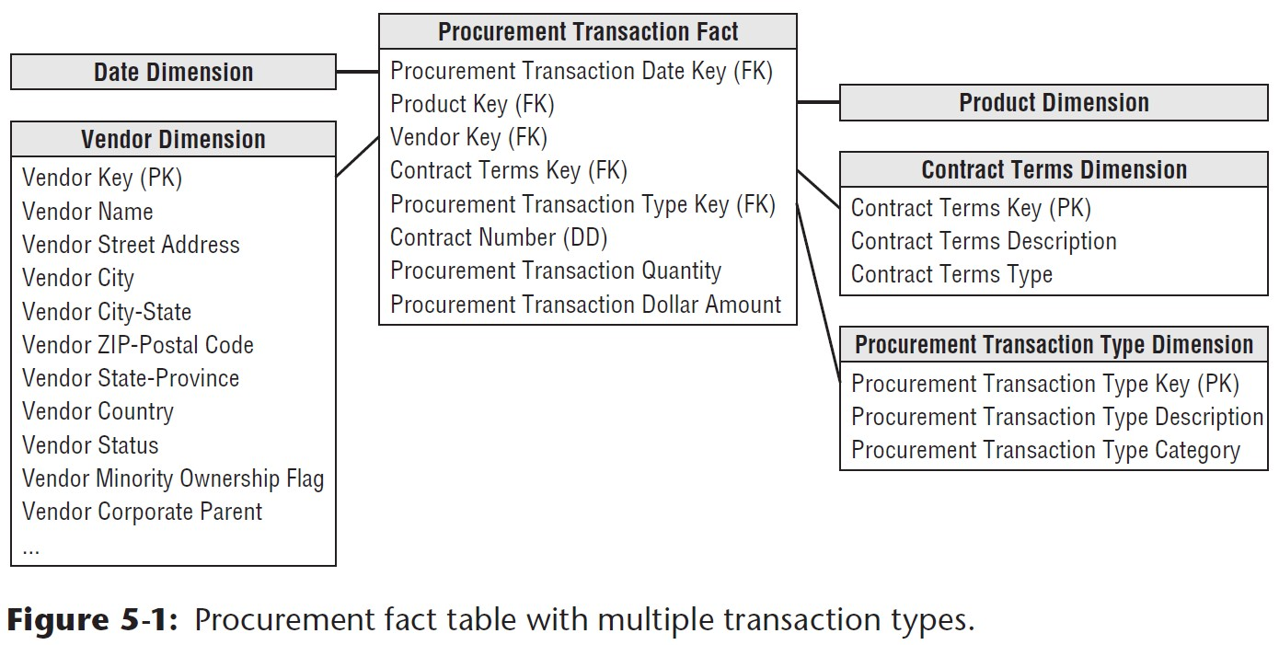
New to this schema:
Vendor, contract terms, and procurement transaction type dimensions.
Raw materials product dimension may be separate from retail product dimension for products being sold.

Slide 8
Single versus Multiple Transaction Fact Tables
Business users view these as separate and unique processes
purchase orders
shipping notices
warehouse receipts
vendor payments
Different dimensions needed
Different control numbers

Slide 9
Single versus Multiple Transaction Fact Tables: Guidelines to consider
Users’ analytic requirements
Multiple unique business processes?
Multiple source systems capturing metrics with unique granularities?
Which dimensions are applicable? Are they different? (“dimensionality of facts”)

Slide 10
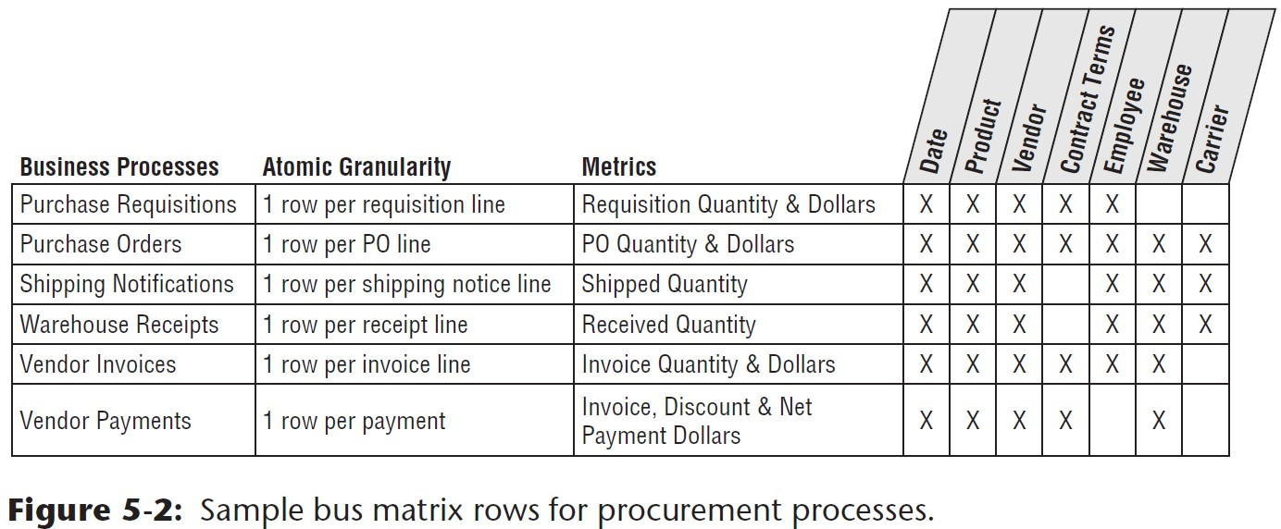
Sample bus matrix rows for procurement processes
“Multiple fact tables enable richer, more descriptive dimensions and attributes”
Easier ETL processing: Loading separate source systems into separate fact tables

Slide 11
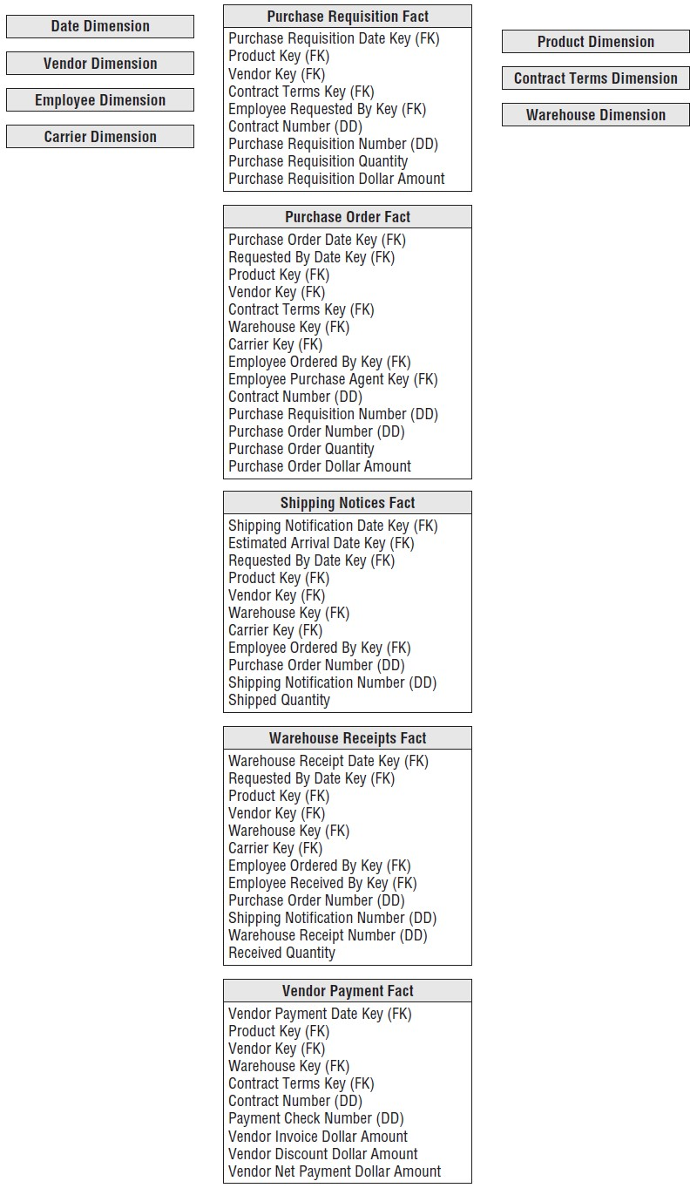
Multiple fact tables for procurement processes

Slide 12
Complementary Procurement Snapshot
Accumulating snapshot models processes with well-defined milestones.
not for modeling a continuous flow that never ends

Slide 13
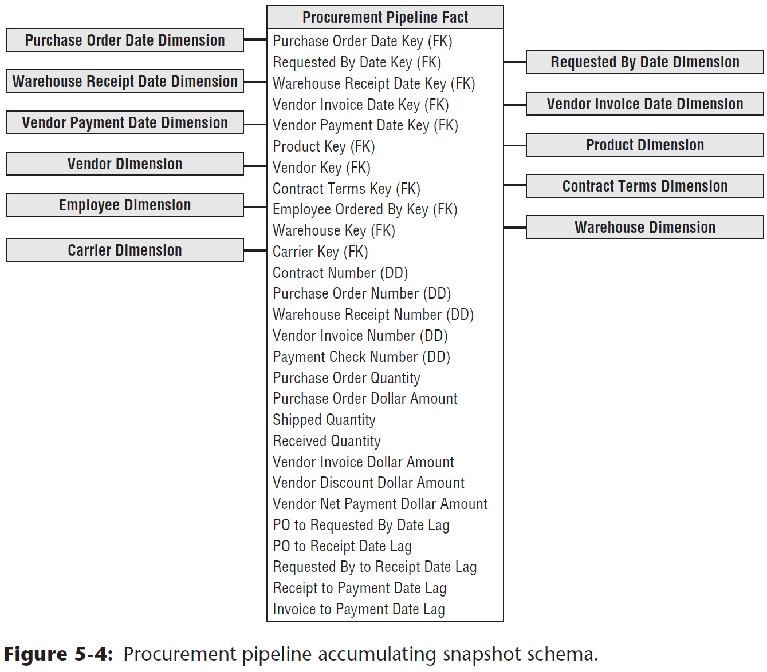
Procurement pipeline accumulating snapshot schema

Slide 14
slowly changing dimension basics

Slide 15
Slowly changing dimensions
Problem: dimensions change slowly over time
For each dimension table attribute, you must have a strategy to handle change.
When things change in the operational world, how will the dimensional model reflect that change?

Slide 16
Type 0: Retain original
These values never change; never allowed to change.
Most attributes in a date dimension.
Persistent durable keys are Type 0.

Slide 17
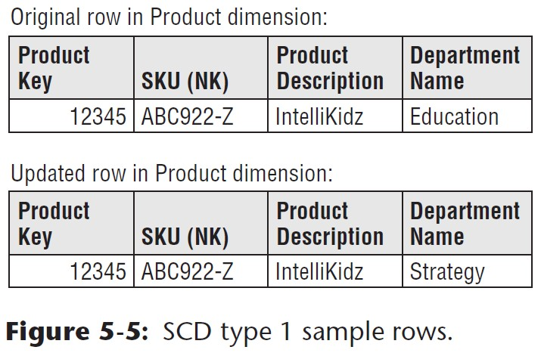
Type 1: Overwrite

Slide 18
Type 1: Overwrite
Suppose sales of product takes off following its move to the Strategy department?
Would you have information to explain the performance improvement?
No history of attribute changes
In OLAP: Performance aggregations need to be recalculated

Slide 19
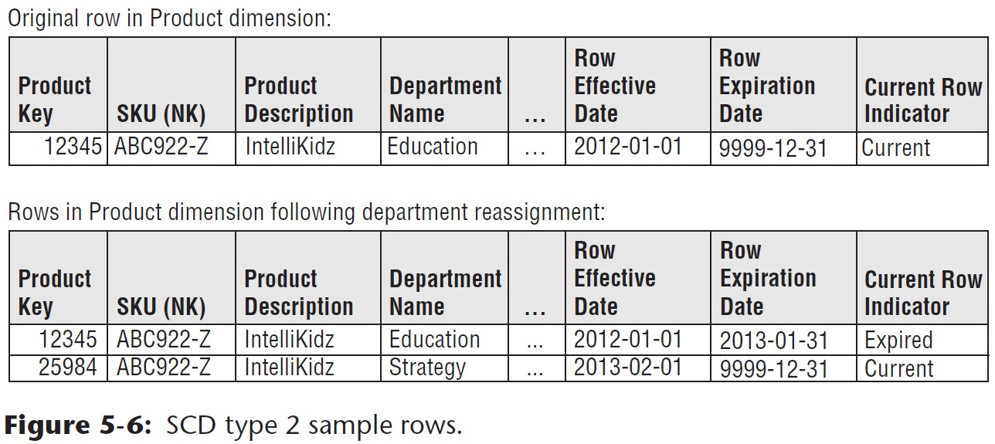
Type 2: Add New Row

Slide 20
Type 2: Add New Row
In OLAP: no need for re-processing
Which key is used to count products correctly?
Suppose e-retailer sells $500 of IntelliKidz software during Jan 2013, followed by a $100 sale in Feb 2013. What are the results of a query reporting Jan and Feb sales:
under a Type 1 change?
under a Type 2 change?

Slide 21
Type 2: Effective and Expiration dates
Support precise time-slicing of the dimension
Use a BETWEEN command to find dimension rows effective on a certain date
End date must be set just prior to the effective date; this is ok if there is no more than one change per day
Or use this logic for more precision: “>= effective date AND < expiration date”
If you have multiple changes in the same day, then use a date/time stamp
Surrogate keys are REQUIRED, to link fact and dimension tables

Slide 22
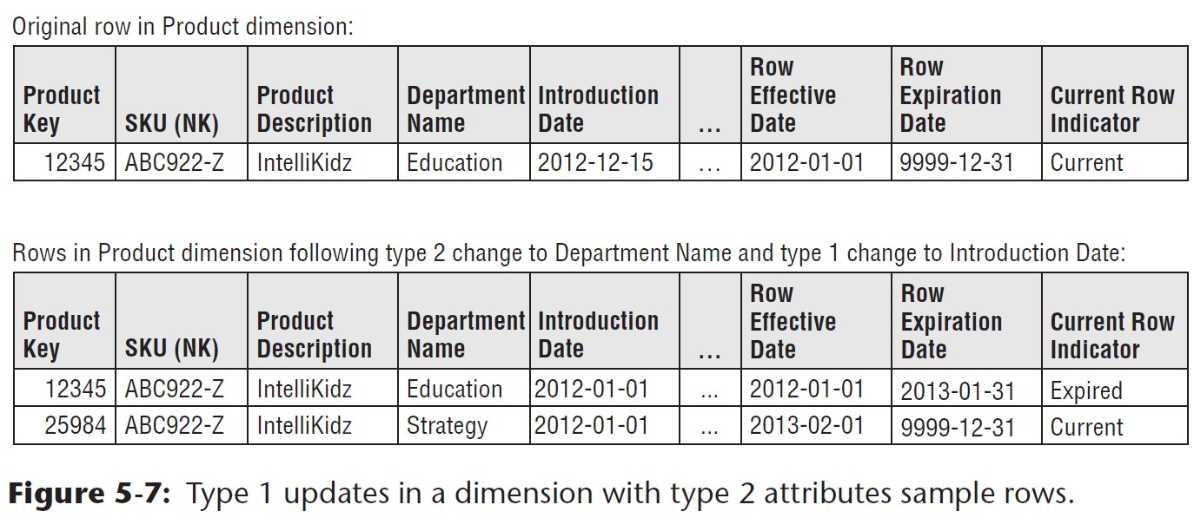
Type 1 Attributes in Type 2 Dimensions
requires updating multiple dimension rows

Slide 23
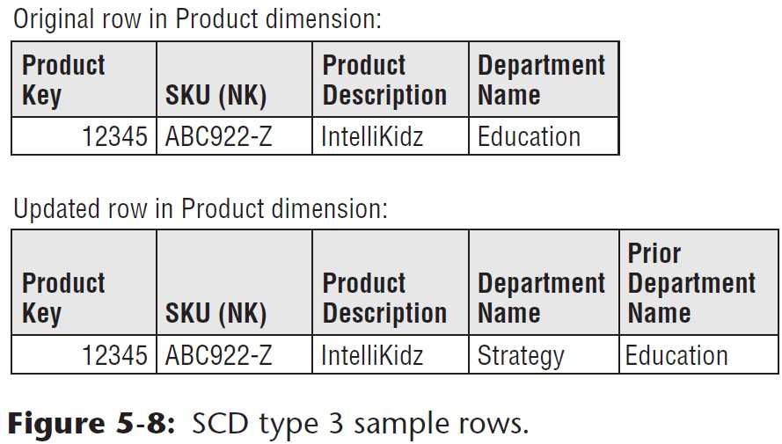
Type 3: Add New Attribute

Slide 24
Type 3: Add New Attribute
What if you need to continue tracking fact data in both old and new departments?
as if the change never happened
Show two views of the world simultaneously
All existing reports automatically switch over to the new classification
You can still query on the old classifications

Slide 25
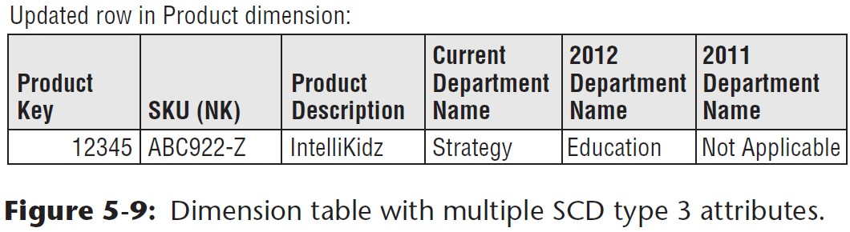
Multiple Type 3 Attributes
Use the current department name most frequently

Slide 26
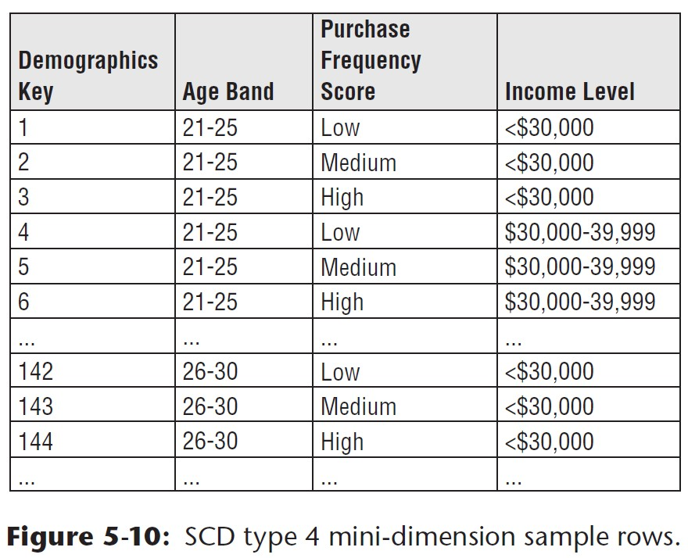
Type 4: Add Mini-Dimension

Slide 27
Type 4: Add Mini-Dimension
For volatile customer demographic attributes: age, purchase frequency score, income level
Mini-dimension tables are much smaller than the main customer dimension
You may have millions of customers; but much fewer mini-dimension rows.
Use pre-defined band ranges
If users need a specific raw data value (e.g. credit bureau score), include it in the fact table

Slide 28
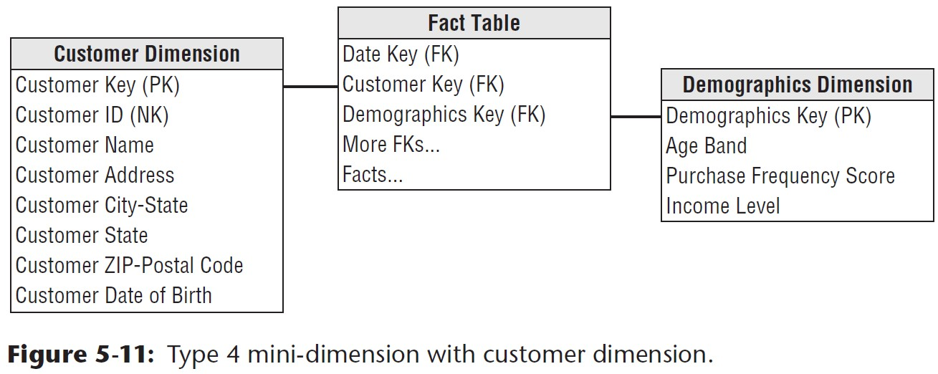
Type 4: Add Mini-Dimension
For each fact table row, use two foreign keys: customer dimension key and mini-dimension demographic key
mini-dimension table provides smaller point of entry to the facts
Just add a row whenever a customer’s demographic profile changes
OLAP reprocessing needed?
Alternative for point-in-time profiling: Use a supplemental factless fact table with effective and expiration dates; capture every relationship change

Slide 29
hybrid slowly changing dimension techniques

Slide 30
Hybrid slowly changing dimensions
Use these (type 5-7) only if they are specifically needed to address business requirements
Otherwise, stick with more simple types 1 through 4 SCDs

Slide 31
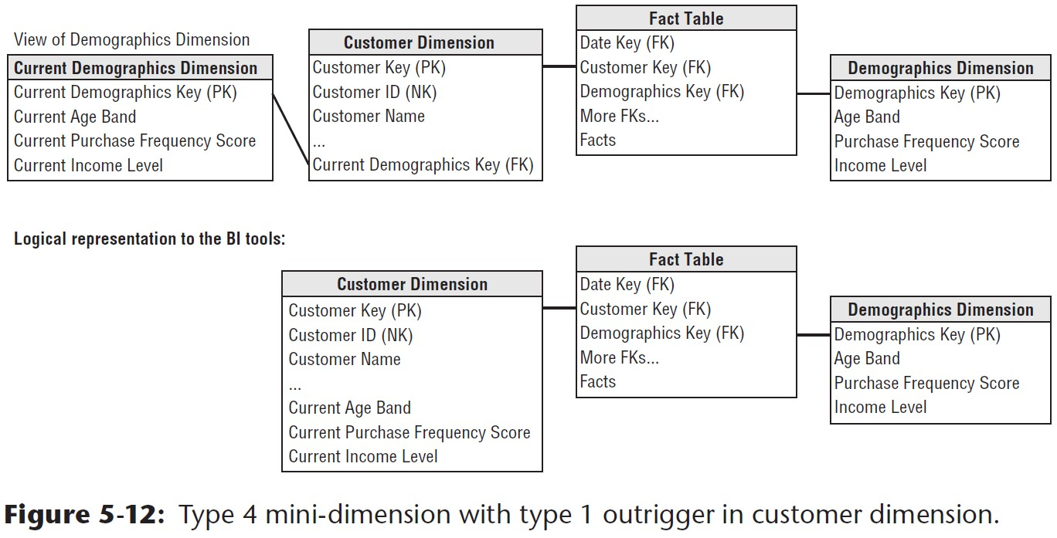
Type 5: Mini-dimension and type 1 outrigger

Slide 32
Type 5: Mini-dimension and type 1 outrigger
Add a current mini-dimension key as a type 1 attribute to the primary dimension
Not as a type 2! This would cause an already large dimension (like customers) to explode in size.
Why useful? You can roll up historical facts based on customer’s current profile; or have a current profile count.

Slide 33
Represent the primary dimension and mini-dimension outrigger as a single logical table in the presentation area
Distinguish column names in the current attributes dimension (current age, current income, etc.)

Slide 34
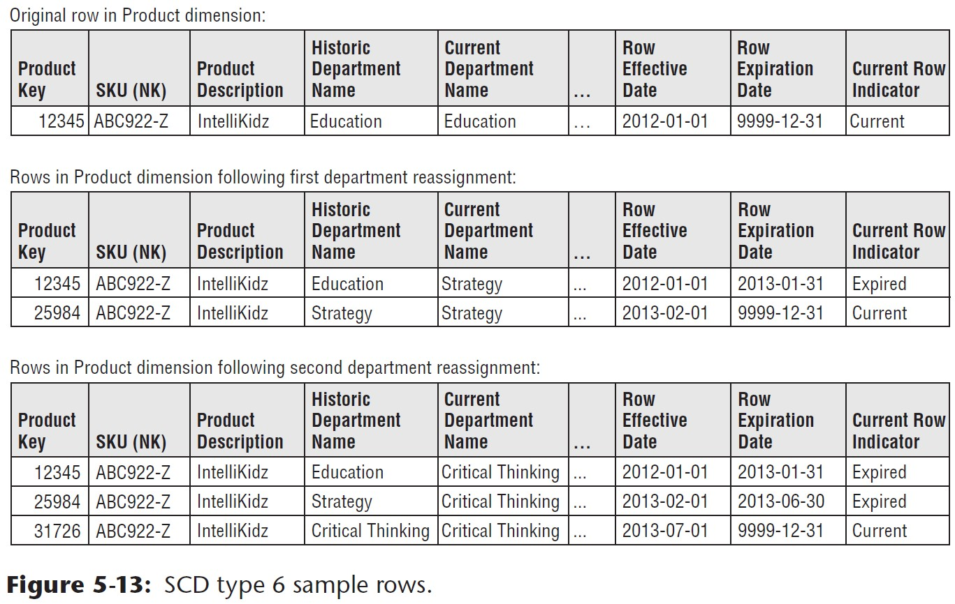
Type 6: Add Type 1 Attributes to Type 2 Dimension

Slide 35
Type 6: Add Type 1 Attributes to Type 2 Dimension
Why useful? You can use historic attributes to group facts in effect when they occurred
Issue a new row to capture a change (type 2); and add a new column to track the current assignment (type 3).
Overwrite the current department name (type 1)

Slide 36
Type 7: Dual Type 1 and Type 2 Dimensions
What if we want both current and historic perspectives on 150 attributes in a large dimension table?

Slide 37
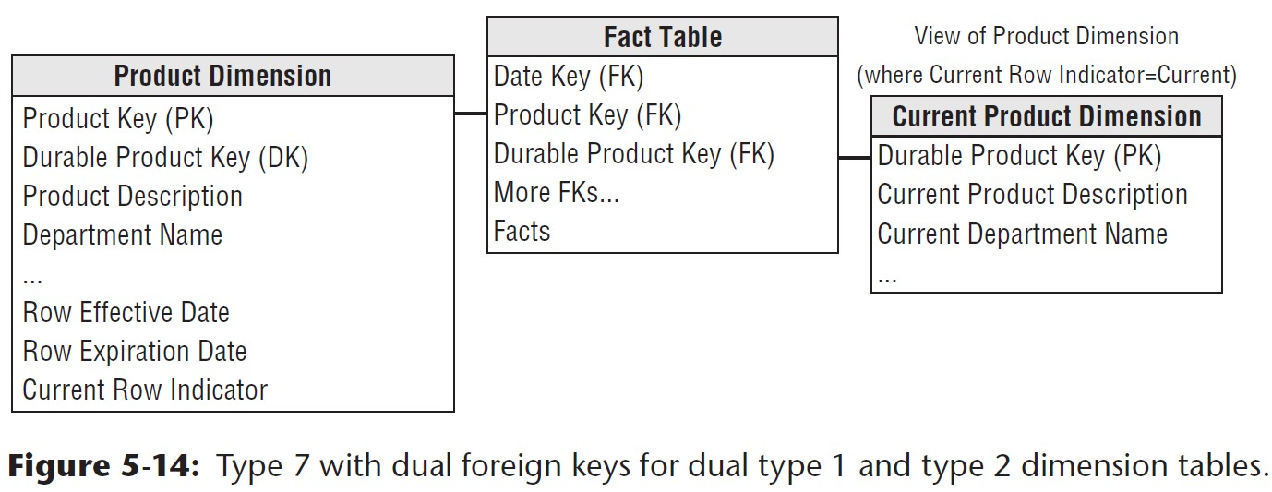
Type 7 for Random “As of” Reporting
Query based on Current Product dimension– small point of entry
Notes:
Delivers the same functionality as type 6.

Slide 38
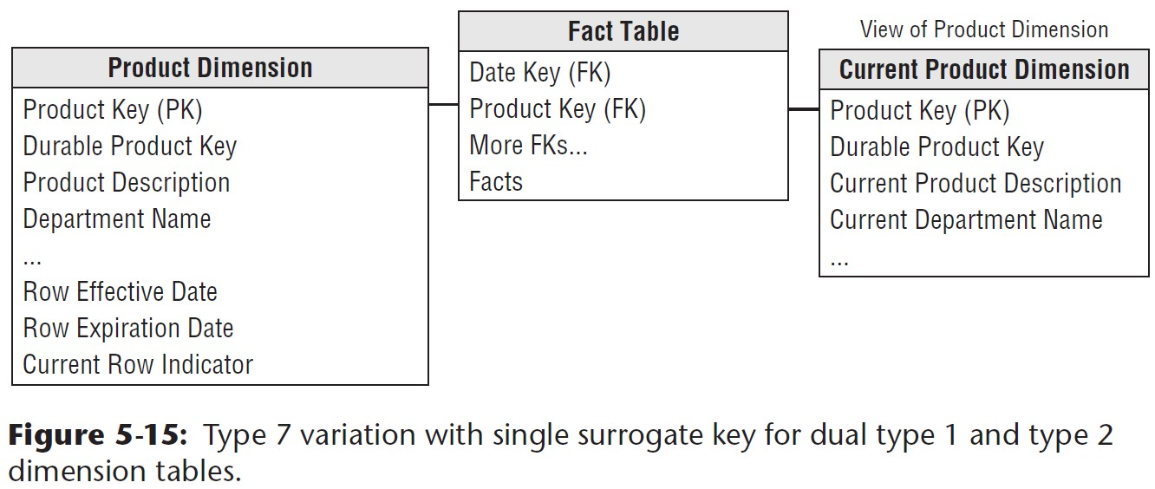
Variation of Type 7

Slide 39
slowly changing dimension recap

Slide 40
